Slide 1
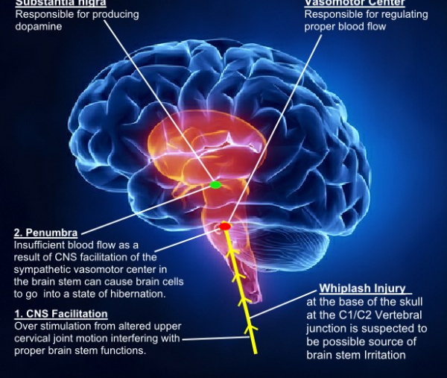
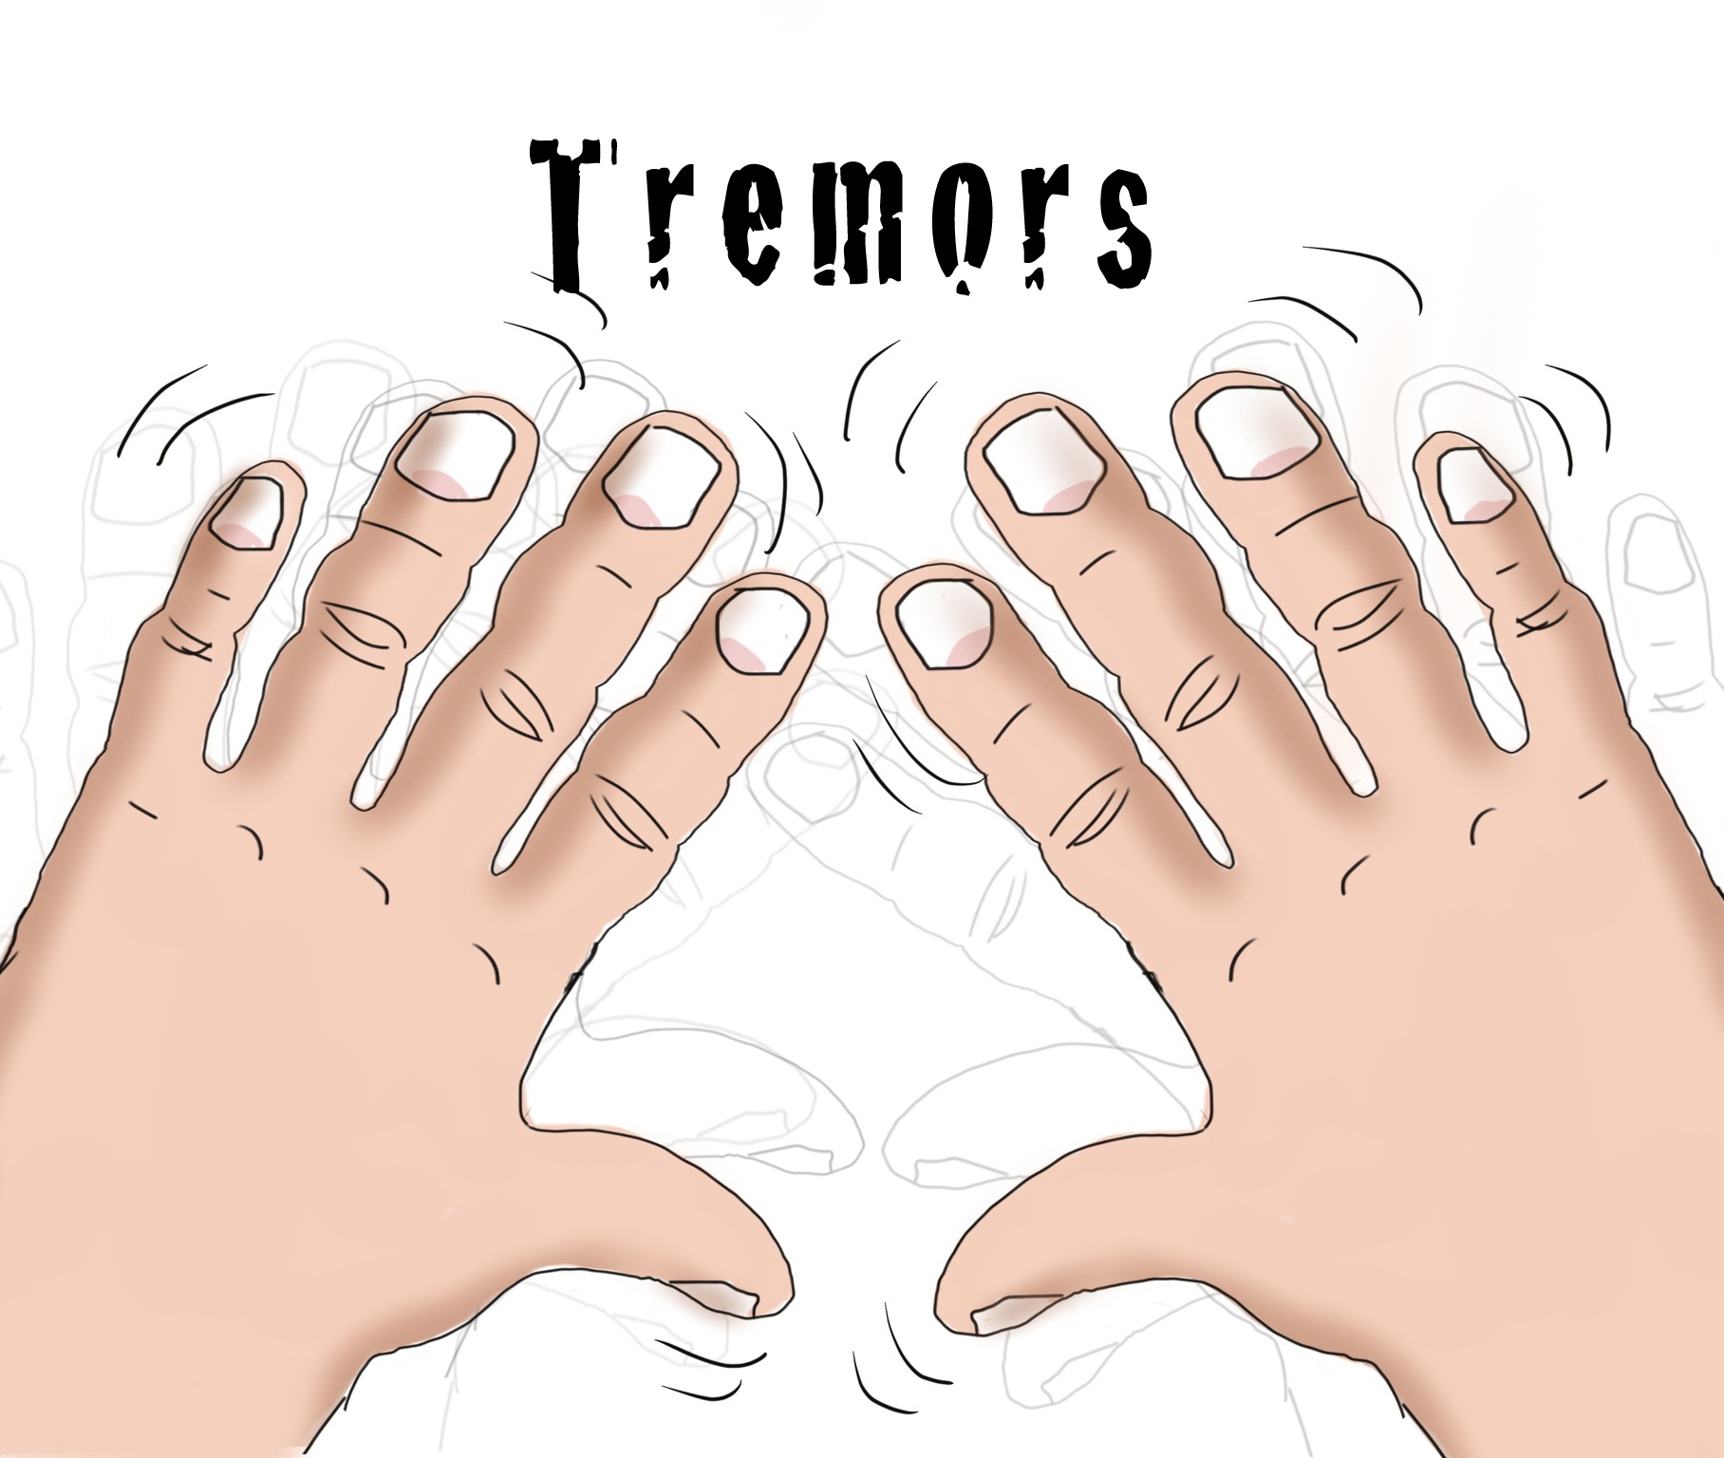
PARKINSON’S DISEASE
Prof. Zhiguo Zhou

Slide 2

Bharadwaj Joshi.
Mamta Sinha.
Pooja Patil.

Slide 3

DATASET.
DATA PRE-PROCESSING.
NAÏVE BAYES.
K-NEAREST NEIGHBORHS.
LINEAR SVM.
KERNEL SVM.
FEATURE SELECTION
TECHNIQUES.
NEURAL NETWORK.
RANDOM FOREST
AUTO ML
CLASSIFIER COMPARISON.

Slide 4
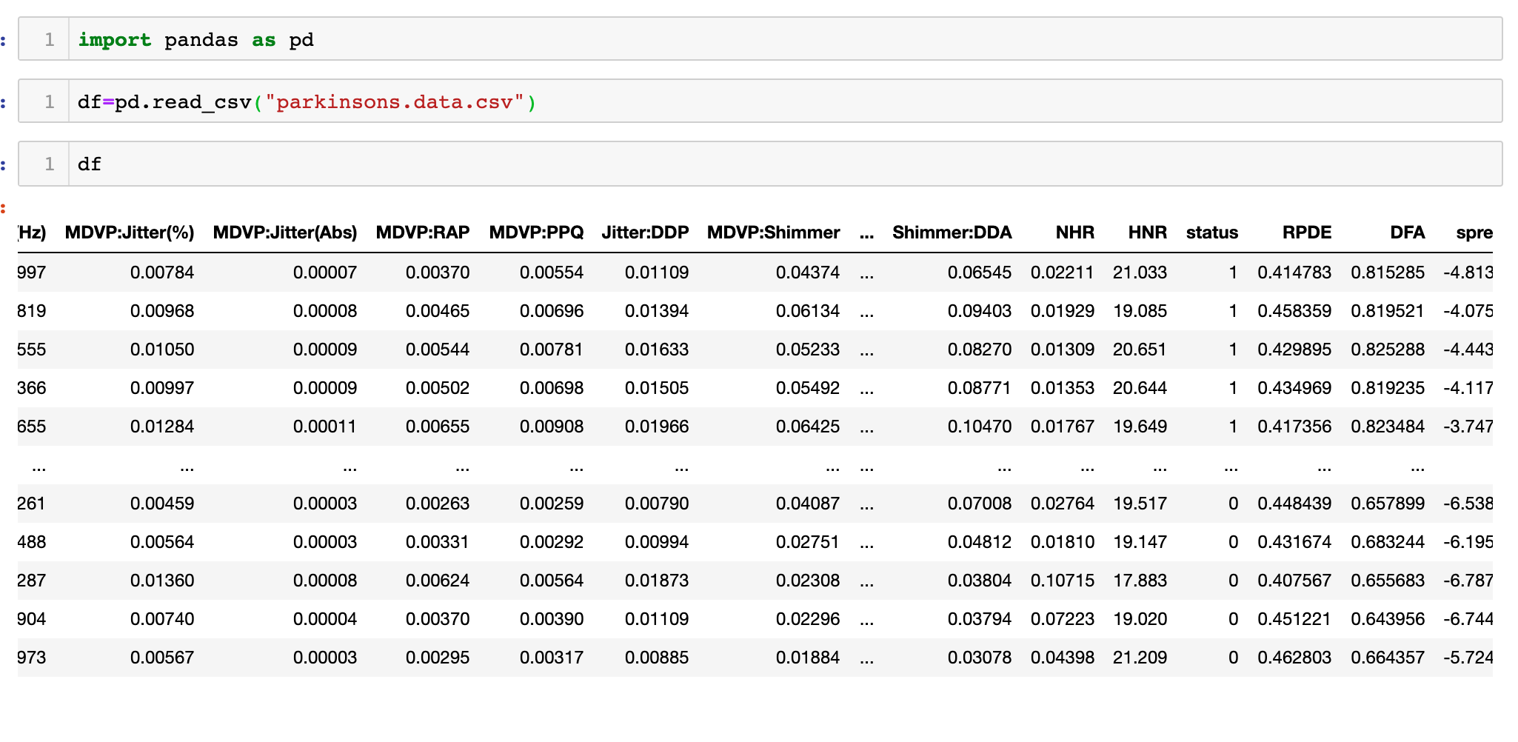
DATASET

Slide 5
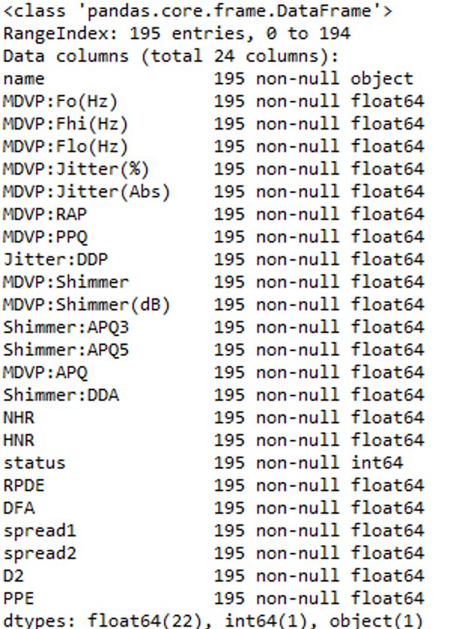
BEFORE DATA
PRE-PROCESSING.
Values of the attributes prior to
Data pre-processing.

Slide 6
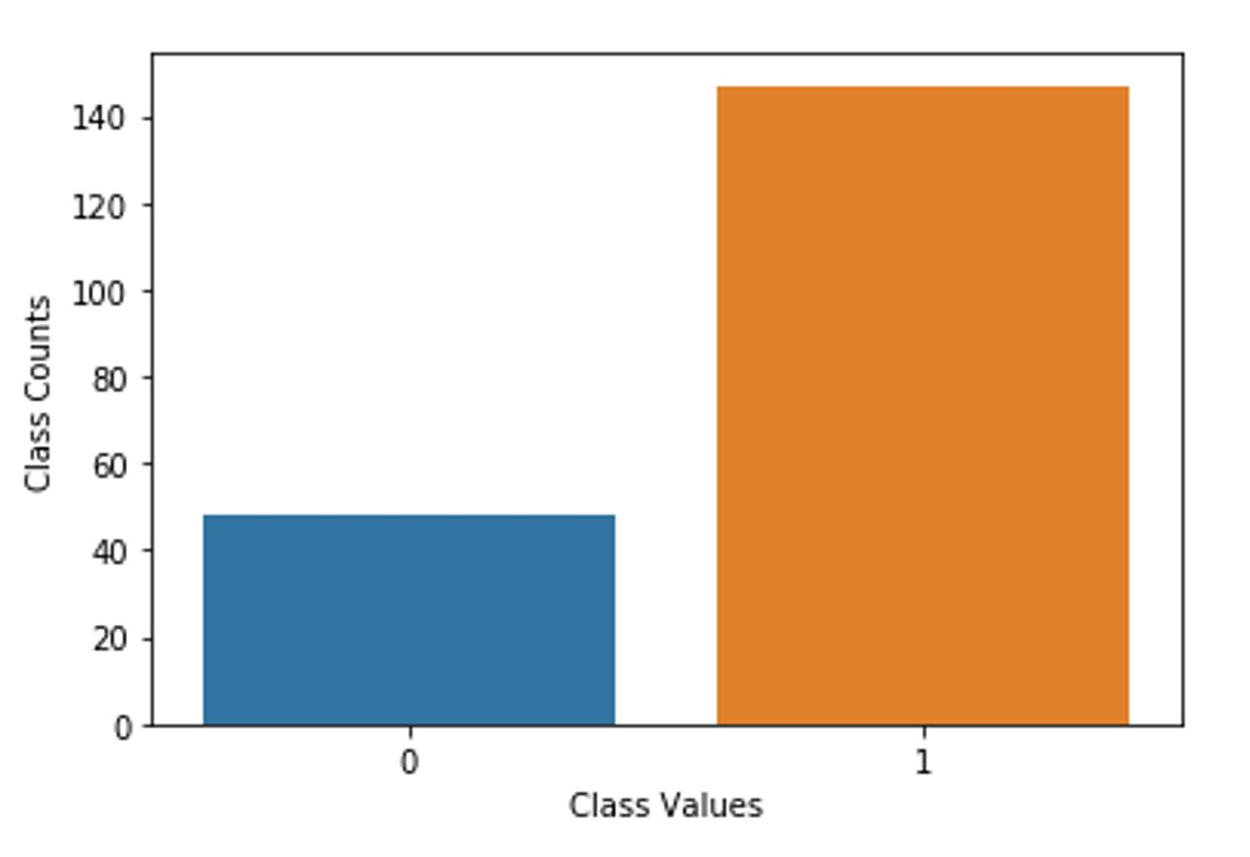
CLASS VARIABLE

Slide 7

DATA CLEANING : REMOVING DUMMY VARIABLE

Slide 8

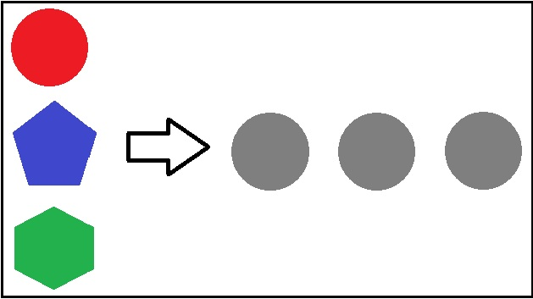
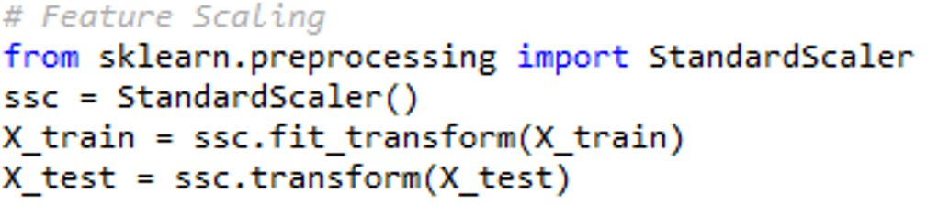
We are using “sklearn.preprocessing.StandardScaler” to standardize features by removing the mean and scaling to unit variance.

Slide 9
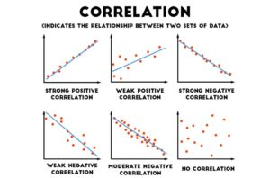
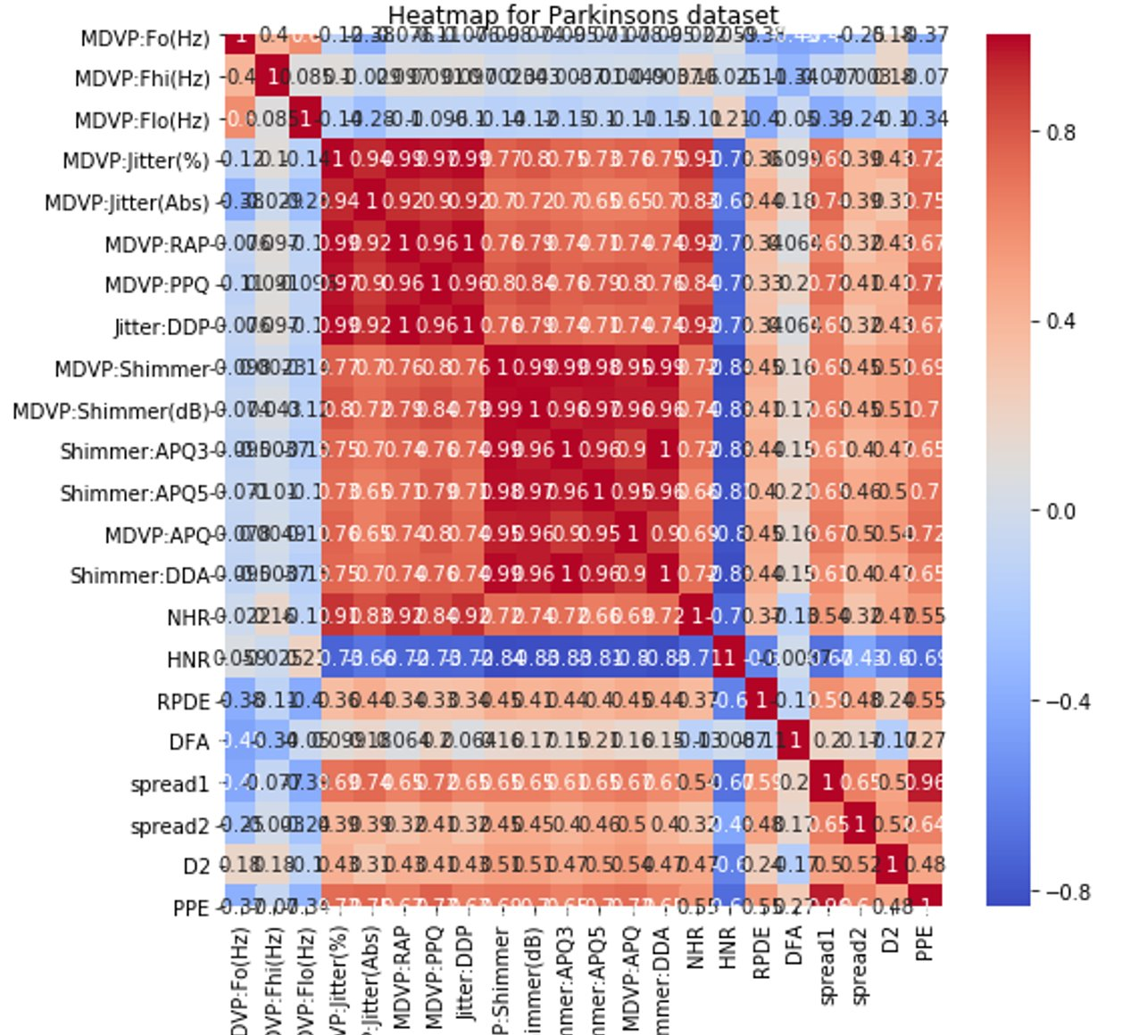
Extracting attribute of high correlation ( >=0.9 )
Generated the heat Map to represent the
correlation​.

Slide 10
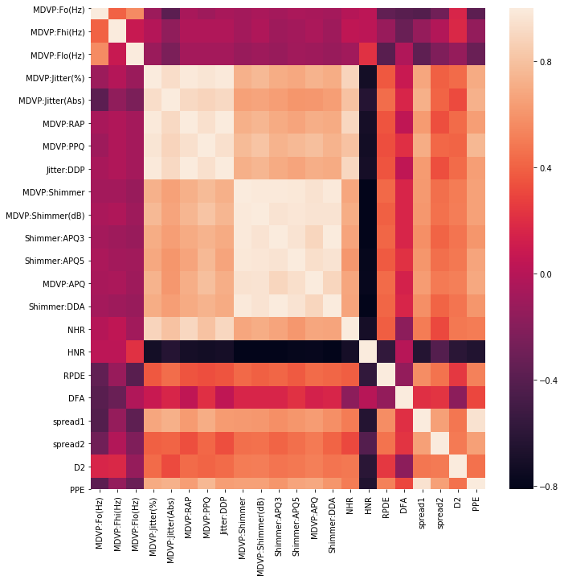

Slide 11
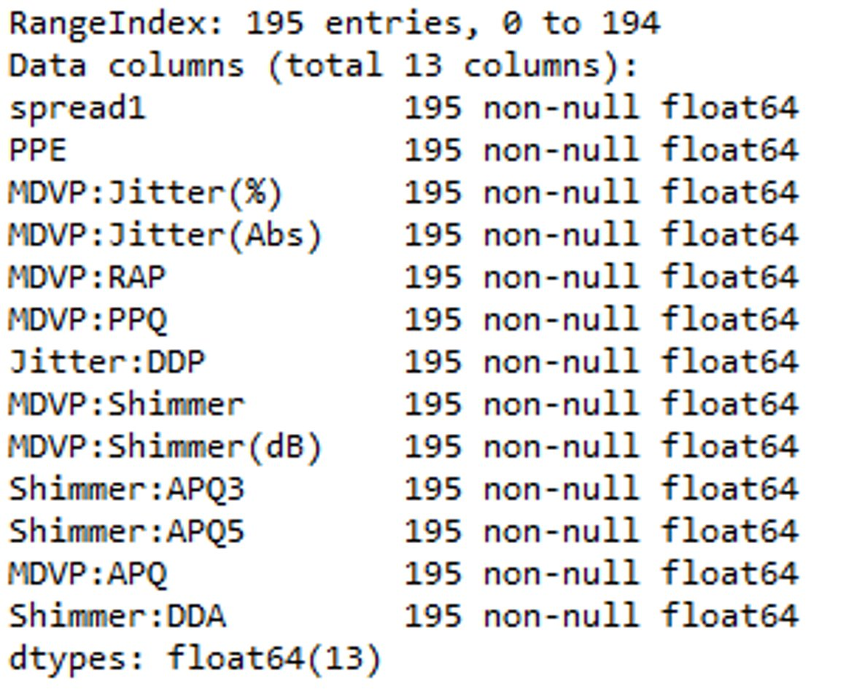
ATTRIBUTES AFTER
PRE-PROCESSING

Slide 12
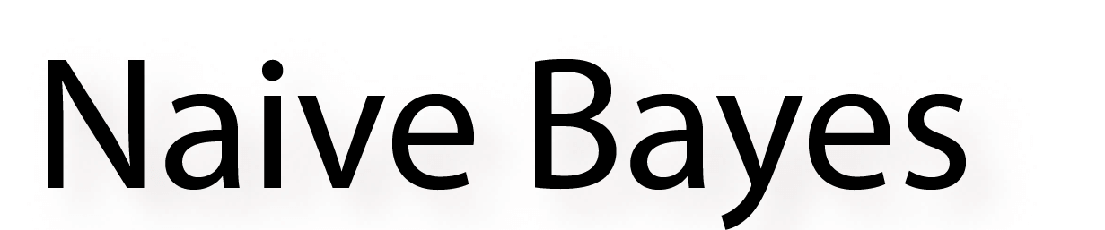
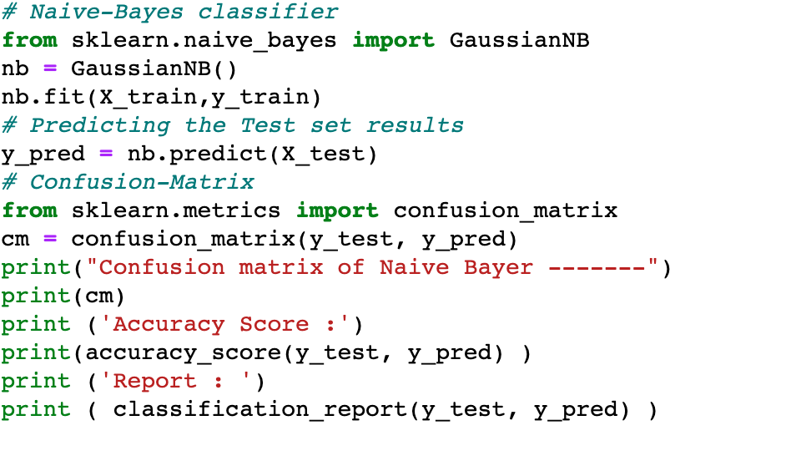
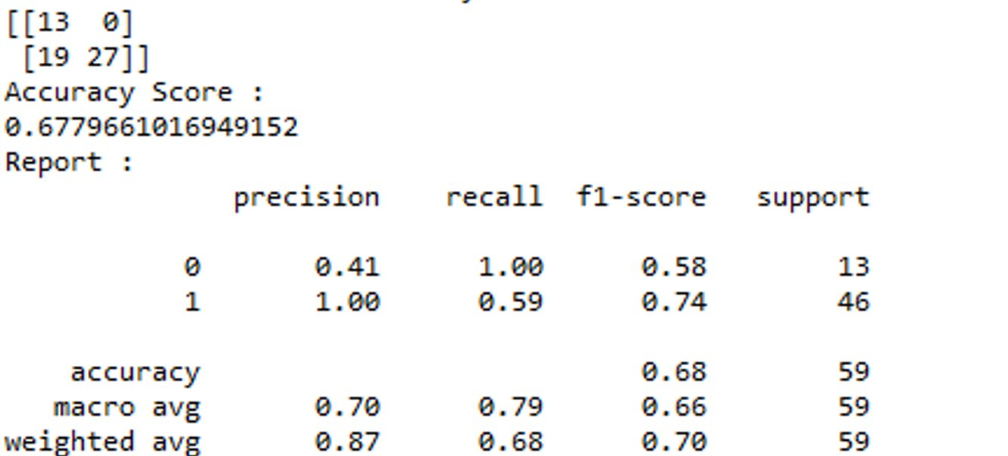

Slide 13
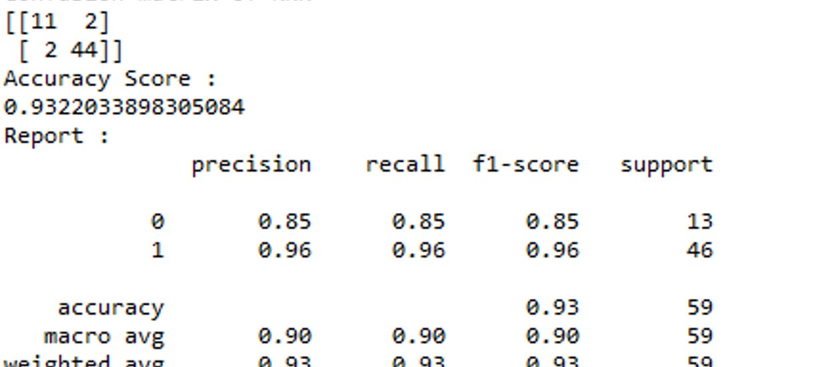
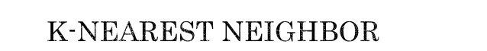
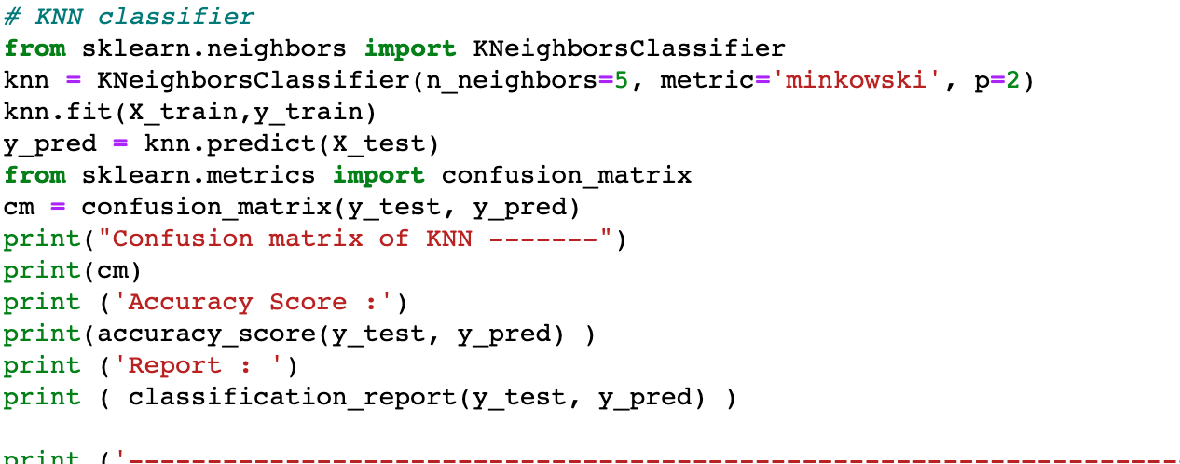

Slide 14
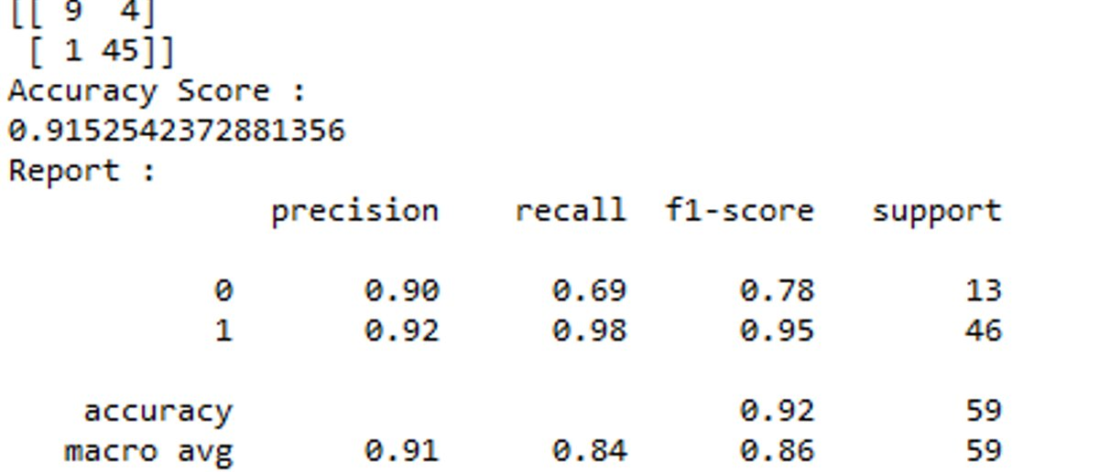
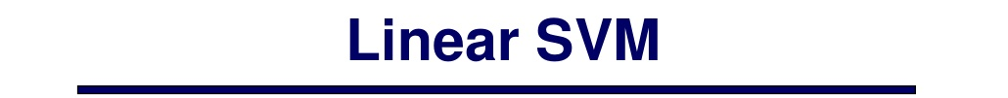
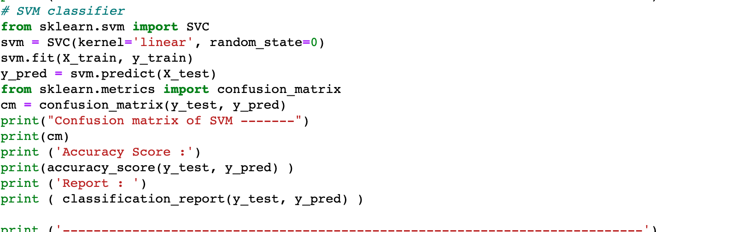

Slide 15
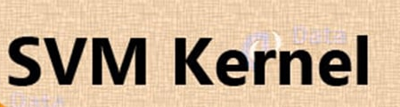
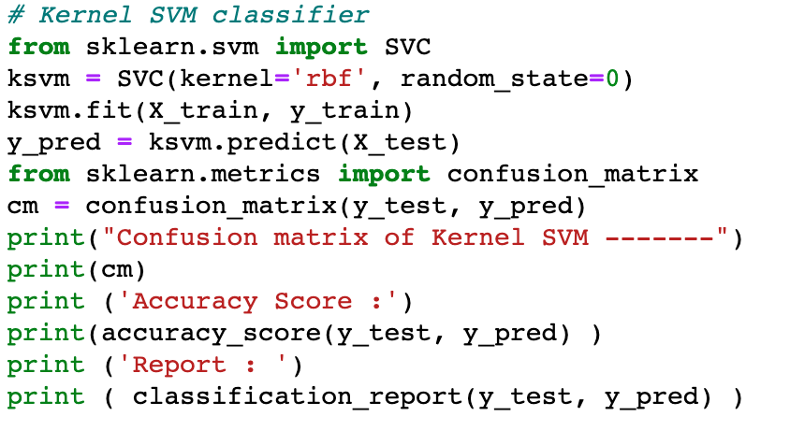
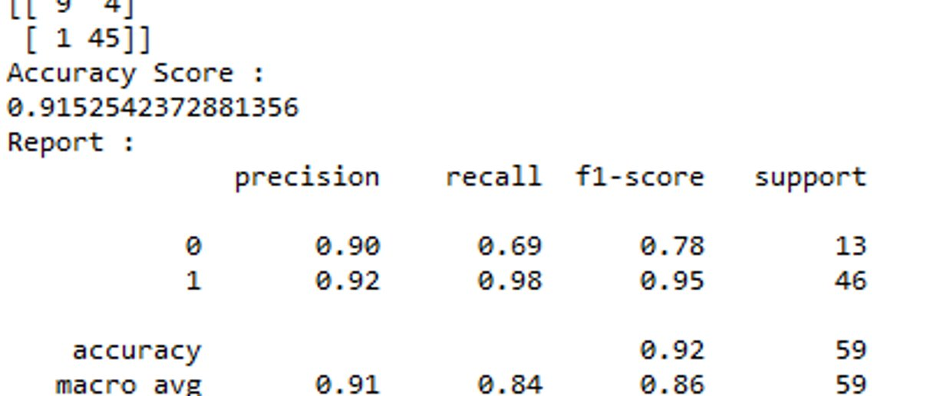

Slide 16
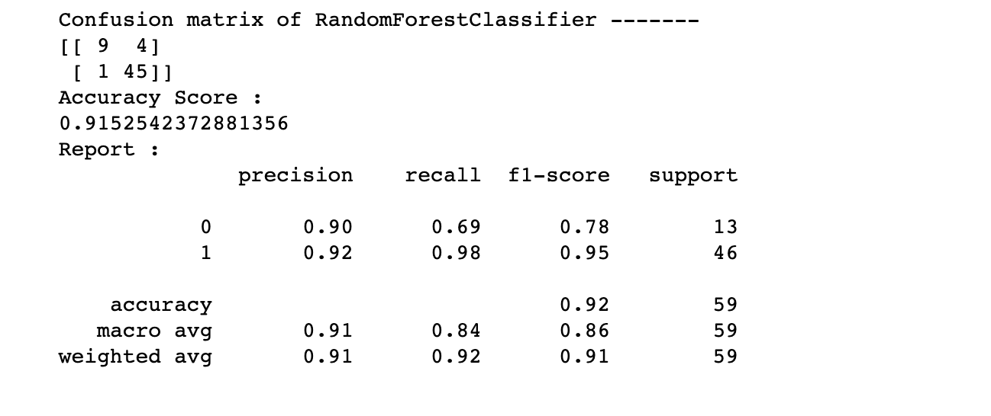
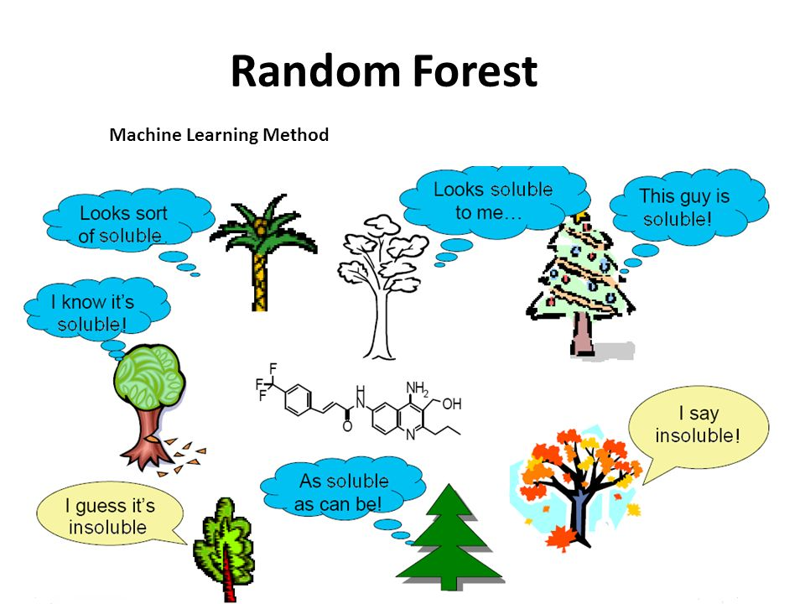
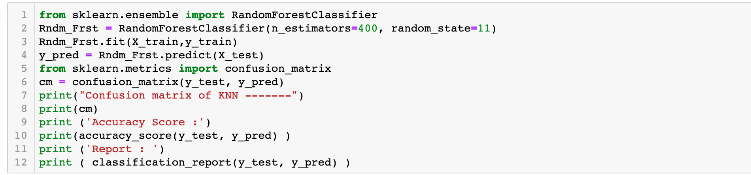

Slide 17
COMPARISION BETWEEN CLASSIFIERS
Classifiers​ | Accuracy​ | F1 score (0/1)​
Naïve Bayer​ | 0.67​ | 0.58/0.74​
KNN​ | 0.93​ | 0.85/0.96​
Linear SVM​ | 0.915​ | 0.78/0.95​
SVM with Kernel​ | 0.915​ | 0.78/0.95​
Random Forest​ | 0.915​ | 0.78/0.95​
Artificial Neural Network​ | 0.9322​ | 0.82/0.96​

Slide 18
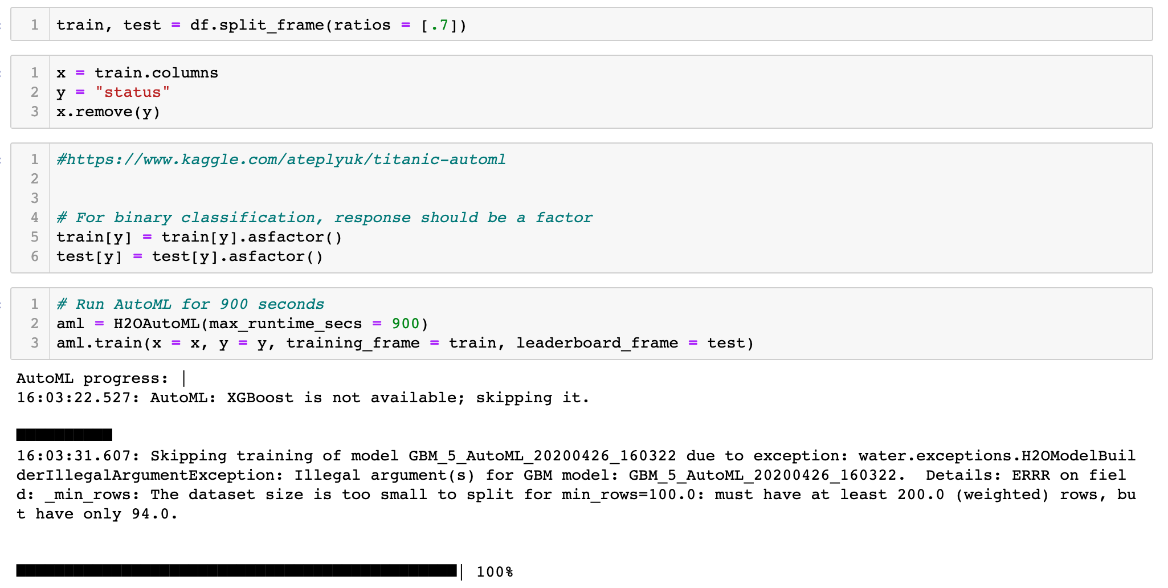

Slide 19
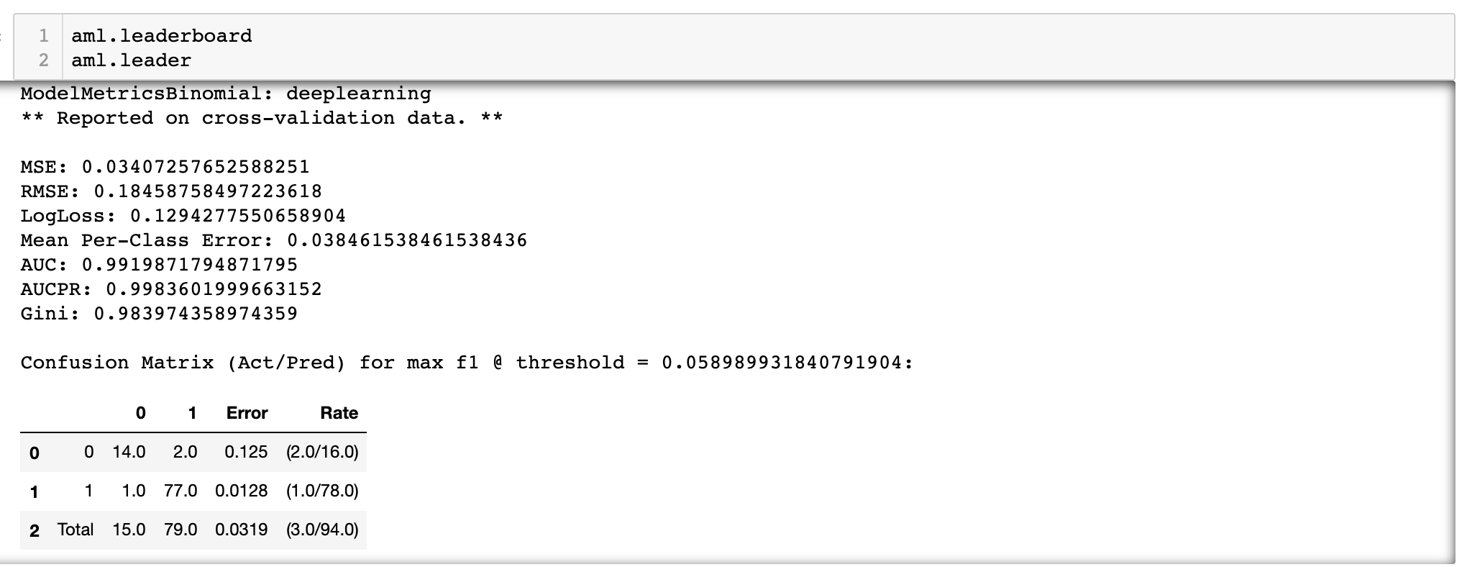
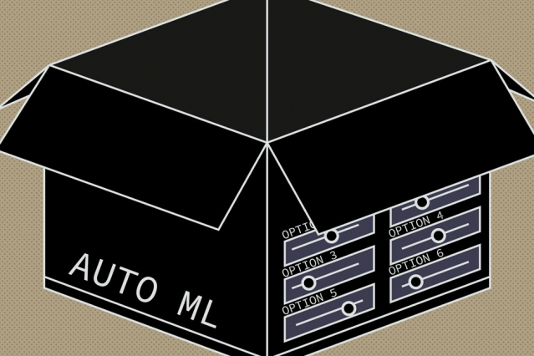
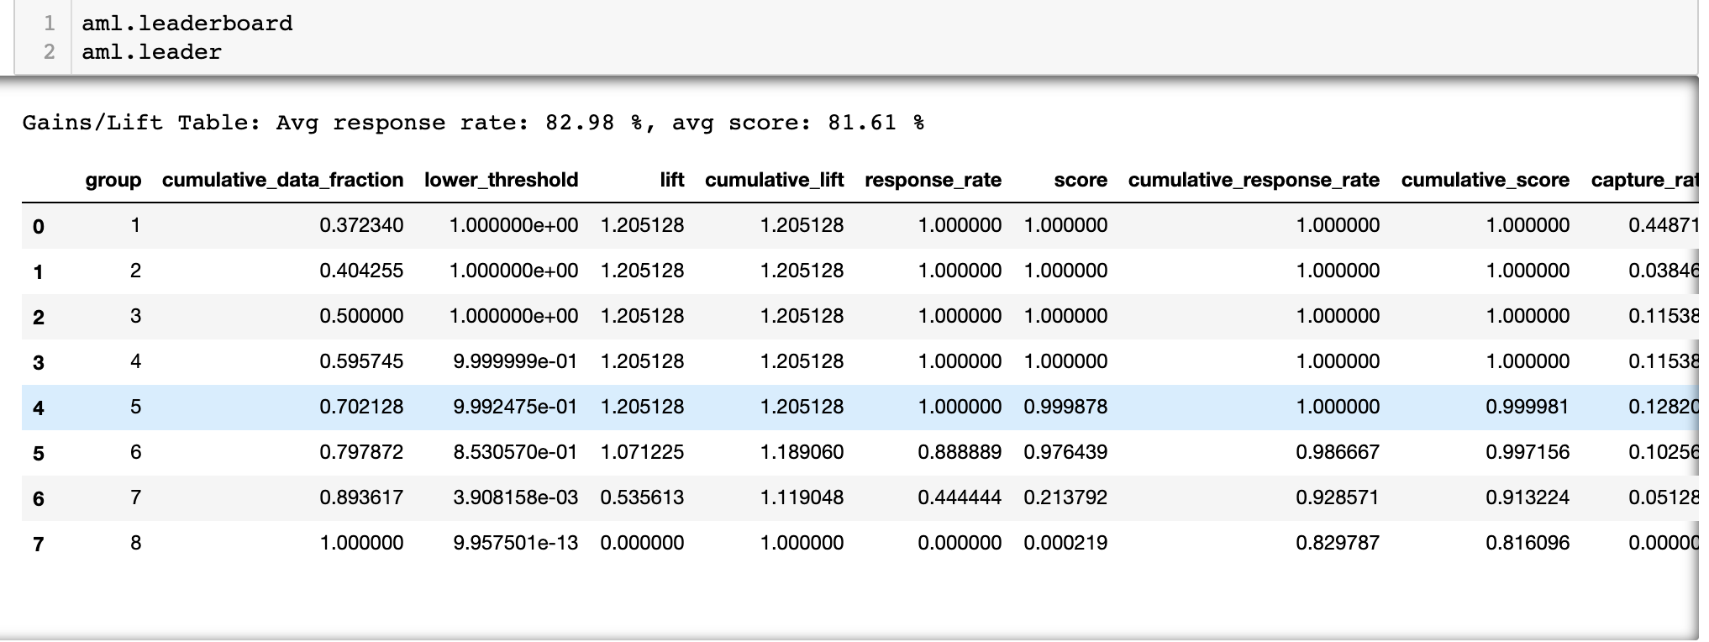

Slide 20
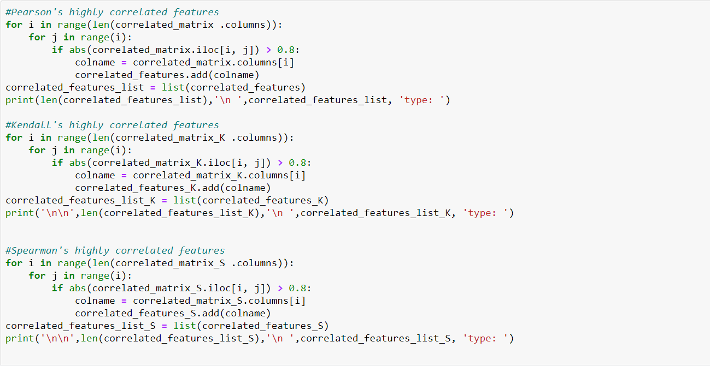
Classification Feature Selection Techniques

Slide 21
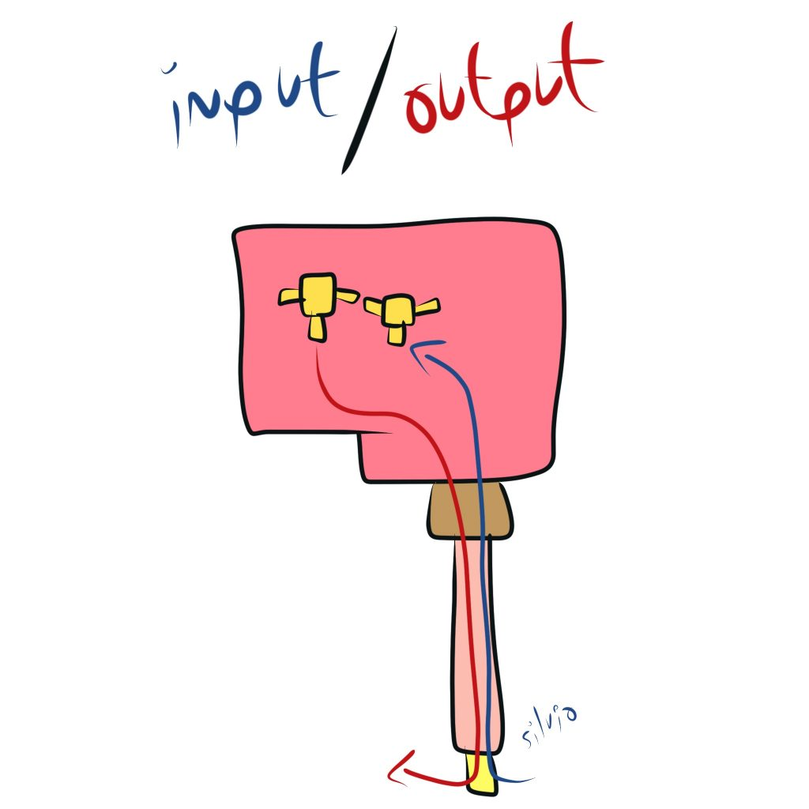
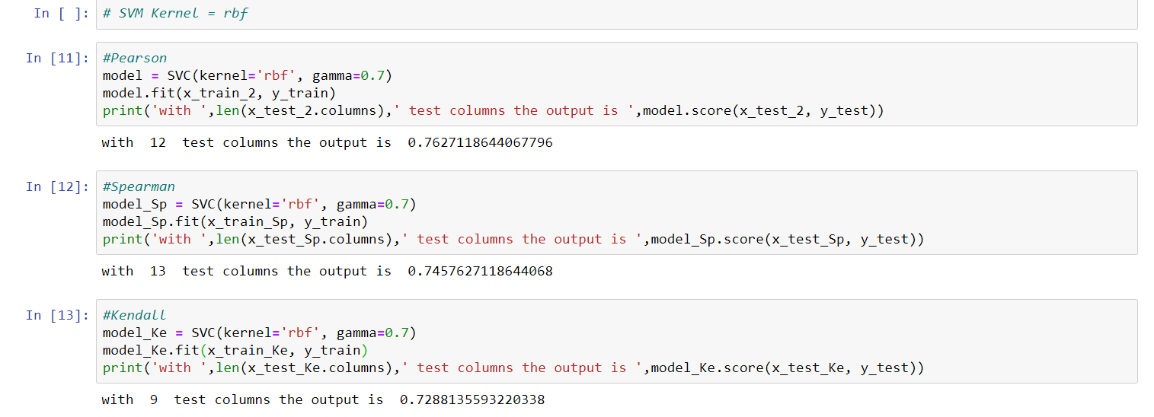

Slide 22
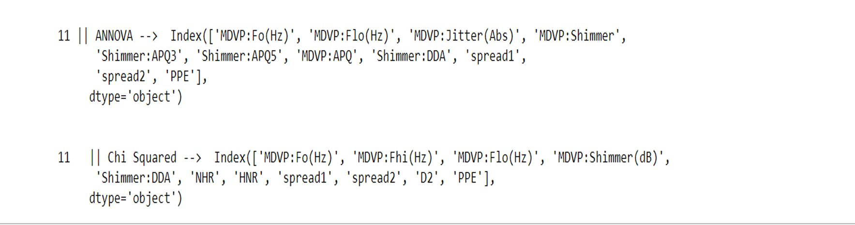
Statistical Feature Selection Techniques
ANNOVA​.
Chi Squared

Slide 23
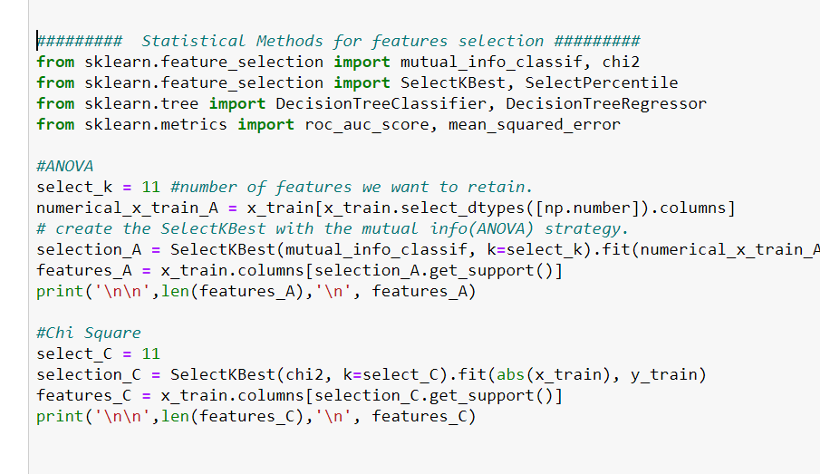

Slide 24
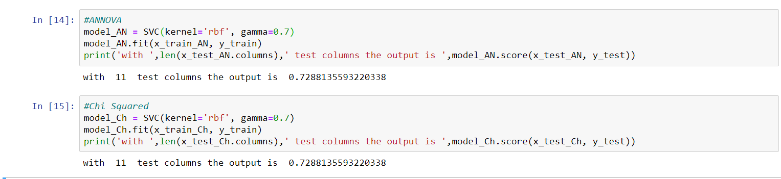

Slide 25
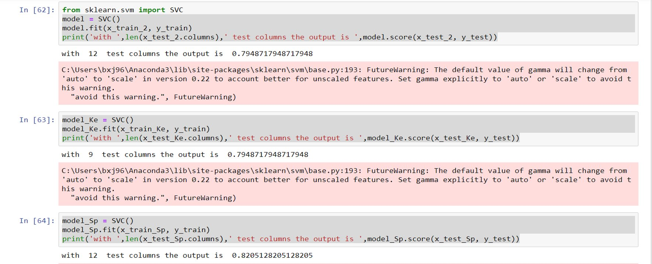
Prediction Results on features selected by Classification technique[SVM - Linear]:
Test split was kept 0.3​.
Only features having correlation greater than 80% qualifies.

Slide 26
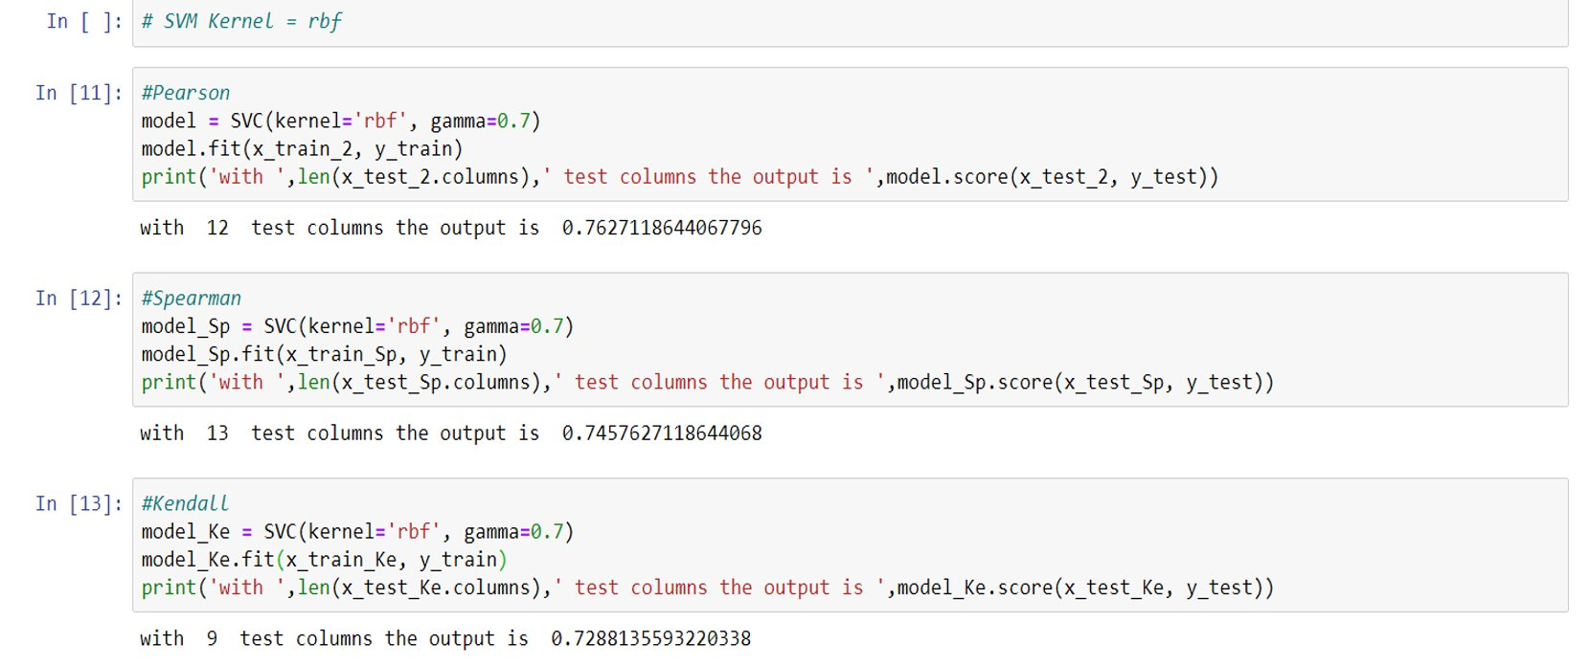
Prediction Results on features selected by Classification technique[SVM - RBF]

Slide 27


